Slide 1
Bank Analytics Project
By group 6 (Excelr)
Piyush R.
Rushikesh S.
Kiran K.

Slide 2
We have worked on this project to get the insights from the Lon Department of the Bank.
Below Are the Main KPI’s which we have extracted from the shared data with us.
1) Year Wise Loan Amount Status.
2) Grade & Subgrade Wise Revolving_Bal
3) Total Payment Done By Verified Status Customer and Non-Verified Status Customers.
4) State and Month wise Loan amount Disbursement Status.
5) Home Ownership Status Vs Last Payment Date.

Slide 3
1) Year Wise loan Amount Stats
The visual represents the year-wise loan amount statistics from 2007 to 2011. Here's a breakdown of the information:
1) 2007 : The loan amount was 2 million.
2) 2008 : The loan amount increased to 14 million.
3) 2009 : The loan amount further increased to 46 million.
4) 2010 : The loan amount saw a significant rise to 122 million.
5) 2011 : The loan amount peaked at 261 million.
There is a consistent upward trend in the loan amounts over the years.
1) The most significant increase occurred between 2009 and 2010.
2) The total increase from 2007 to 2011 is substantial, indicating a growing demand or capacity for loans over this period.

Slide 4
2) Grade & Subgrade Wise revol_bal
The image is a bar chart titled "Grade & Subgrade wise revol Bal." It displays the revolving balance amounts for different grades and subgrades, labeled from A1 to G5. The y-axis represents the balance in millions, ranging from -5.0M to 45.0M. Each bar corresponds to a specific subgrade within a grade, showing the balance amount.
Key observations :- The highest balance is for subgrade B2 at 39.7M.- The lowest balance is for subgrade G5 at 0.7M.- Grades A and B have higher balances compared to grades F and G.- The balances generally decrease from left to right across the grades.This chart provides a visual comparison of revolving balances across different grades and subgrades.

Slide 5
3) Total Payment for Verified Status Vs Non Verified Status
The pie chart provides a visual comparison of total payments for verified versus non-verified statuses. Here's a breakdown of the information:
1) Verified Status:- Total Payment: $220 million- Percentage of Total: 59%
2) Non-Verified Status:- Total Payment: $154 million- Percentage of Total: 41%
The chart shows that a larger portion of the total payments is attributed to verified status, both in terms of dollar amount and percentage.

Slide 6
4) State Wise & Month Wise Loan Status
The image is a stacked area chart showing the loan status by month. Here’s a breakdown of the information:
1) Categories:-Fully Paid (Green)- Current (Yellow)- Charged Off (Orange)
2) Monthly Analysis:-
January: 6 Fully Paid
February: 2 Fully Paid
March: 6 Fully Paid, 2 Charged Off
April: 3 Fully Paid, 1 Charged Off
May: 8 Fully Paid, , 1 Charged Off
June: 3 Fully Paid, , 2 Charged Off
July: 5 Fully Paid
August: 4 Fully Paid, 1 Charged Off
September: 6 Fully Paid, , 1 Charged Off
October: 3 Fully Paid, , 1 Charged Off
November: 7 Fully Paid, 1 Charged Off
December: 10 Fully Paid, 2 Current, 4 Charged Off
3)Totals:- Fully Paid – 63, Current – 2, Charged Off – 15.
4) Trends:- The number of fully paid loans is highest in December.- Charged off loans are present in January, February, March, and December.- Current loans appear in November and December.-

Slide 7
5) Home Ownership Vs Last Payment Date Stats
The image is a Bar chart showing the Home ownership vs Last Payment Status month. Here’s a breakdown of the information:
1) Categories:-Rent (Red)- Own (Yellow)- Mortage (Blue)
2) Yearly Analysis:-
2008: 70 Rent, 11 Own, 56 Mortage
2009: 279 Rent, 39 Own, 229 Mortage
2010: 939 Rent, 185 Own, 706 Mortage
2011: 2408 Rent, 422 Own, 2131 Mortage
2012: 4383 Rent, 700 Own, 3786 Mortage
2013: 4501 Rent, 703 Own, 4254 Mortage
2014: 4424 Rent, 673 Own, 4172 Mortage
2015: 1063 Rent, 160 Own, 1207 Mortage
2016: 780 Rent, 160 Own, 1104 Mortage
3)Totals:- Rent – 18847, Own – 3053, Mortage– 17645.
4) Trends:- The number of Rent is highest in 2013 & Lowest in 2008. The number of Own is highest in 2013 & Lowest in 2008 Similarly, number of Mortage is highest in 2013 & Lowest in 2008. So, In 2013- Having more number of Home Ownership Than 2008.

Slide 8
TECHNOLOGIES USED
To perform the analysis and to get the insights via KPIs we’ve used Below Tools & Technologies.
MS EXCEL : For Data cleaning with precision and to create the base for the analysis.
My SQL : To get the accurate insights from the data.
Power BI : To create the modeling between the database, creating fluent data transmission and for creating the Interactive Graphs.
Tableau : We have used Tableau to create the responsive, User-friendly, informative Dashboards which shows the all the KPIs in a very fluent Manner.

Slide 9
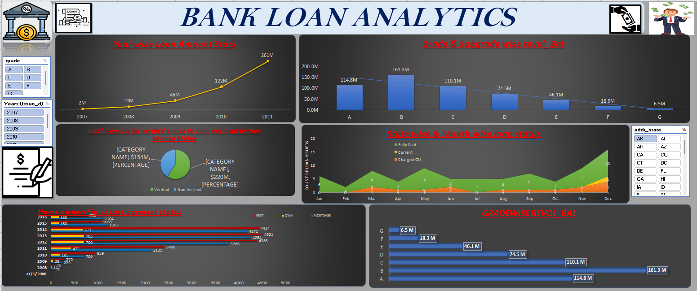
MS Excel Dashboard

Slide 10
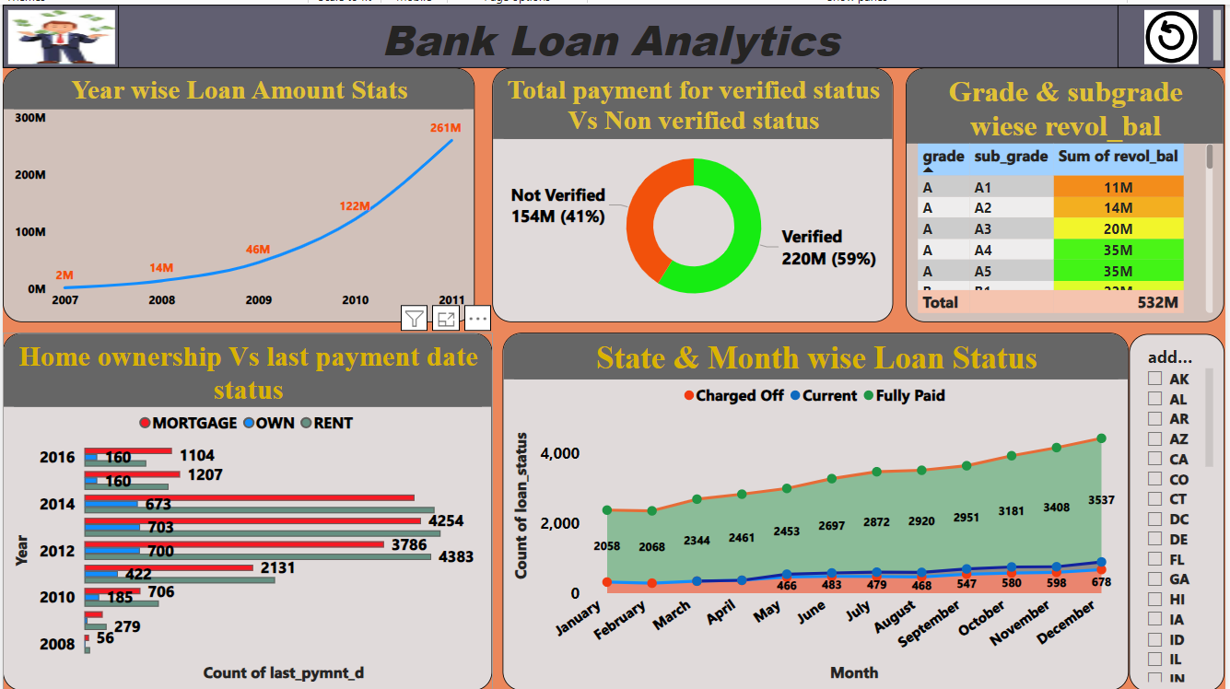
Power Bi Dashboard

Slide 11
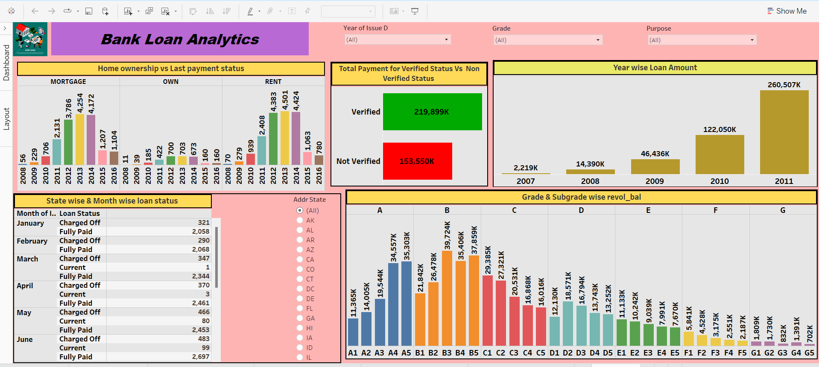
Tableau Dashboard

Slide 12
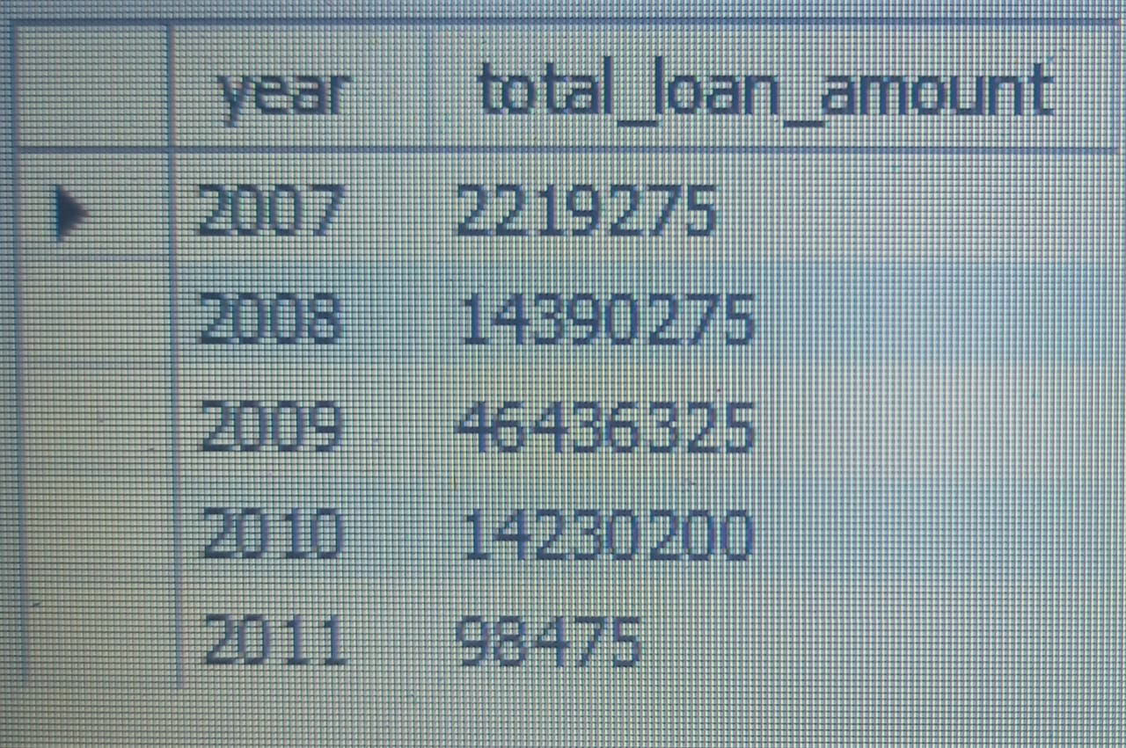
SQL Quaries & Output
1)Year Wise loan Amount Stats - SELECT YEAR(issue_d) AS year, SUM(loan_amnt) AS total_loan_amount FROM finance_1pp GROUP BY YEAR(issue_d) ORDER BY year;

Slide 13
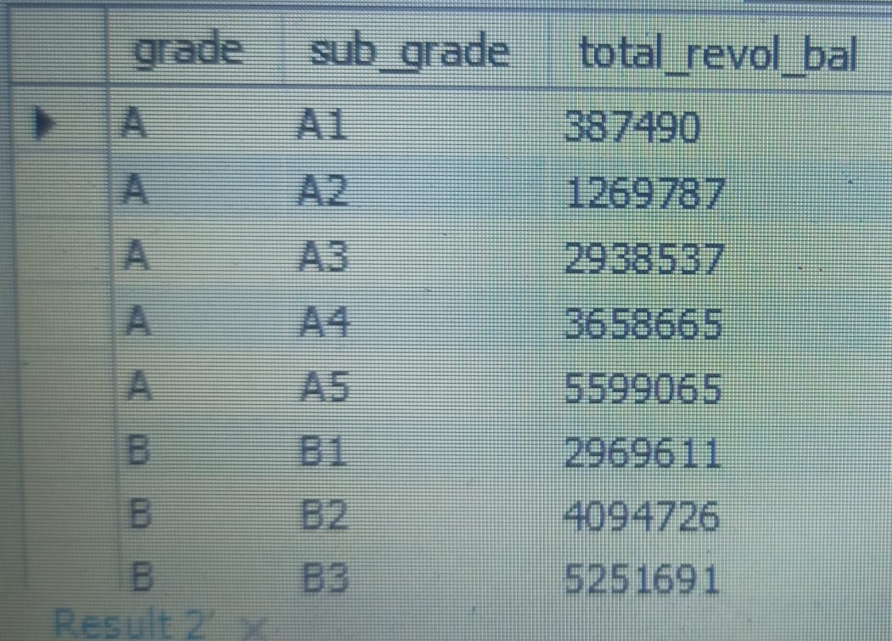
2) Grade & Subgrade Wise revol_bal - select grade , sub_grade , sum(revol_bal) as total_revol_bal from finance_1pp inner join finance_2pp on(finance_1pp.id = finance_2pp.id) group by grade , sub_grade order by grade , sub_grade;

Slide 14
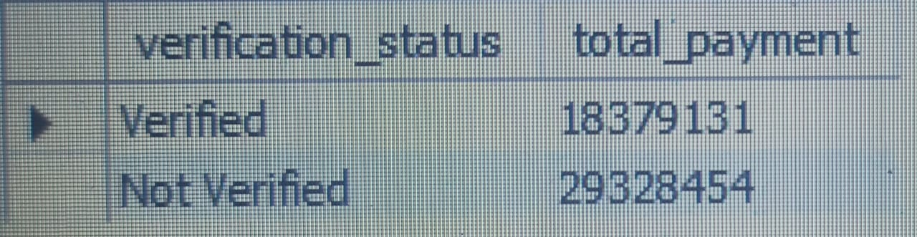
3) Total Payment for Verified Status Vs Non Verified Status - SELECT p.verification_status, SUM(s.total_pymnt) AS total_payment FROM finance_1pp p INNER JOIN finance_2pp s ON p.Id = s.Id WHERE p.verification_status IN ('Verified', 'Not Verified') GROUP BY p.verification_status;

Slide 15
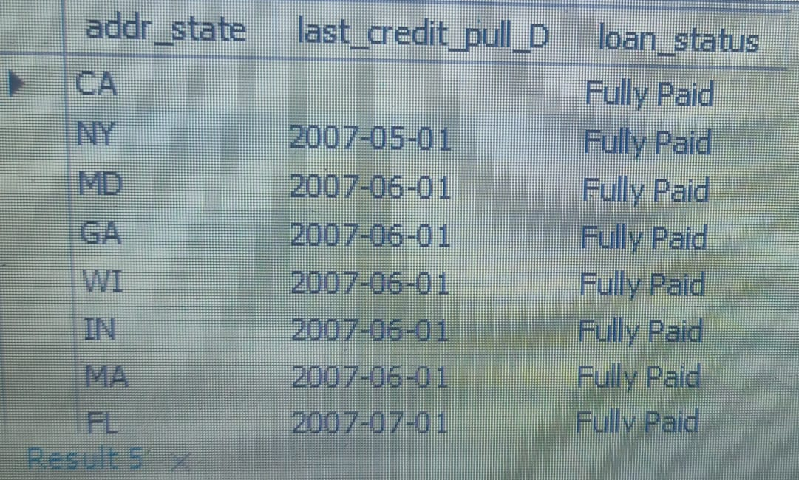
4) State Wise & Month Wise Loan Status - select addr_state , last_credit_pull_D , loan_status FROM finance_1pp p INNER JOIN finance_2pp s ON p.Id = s.Id group by addr_state , last_credit_pull_D , loan_status order by last_credit_pull_D ;

Slide 16
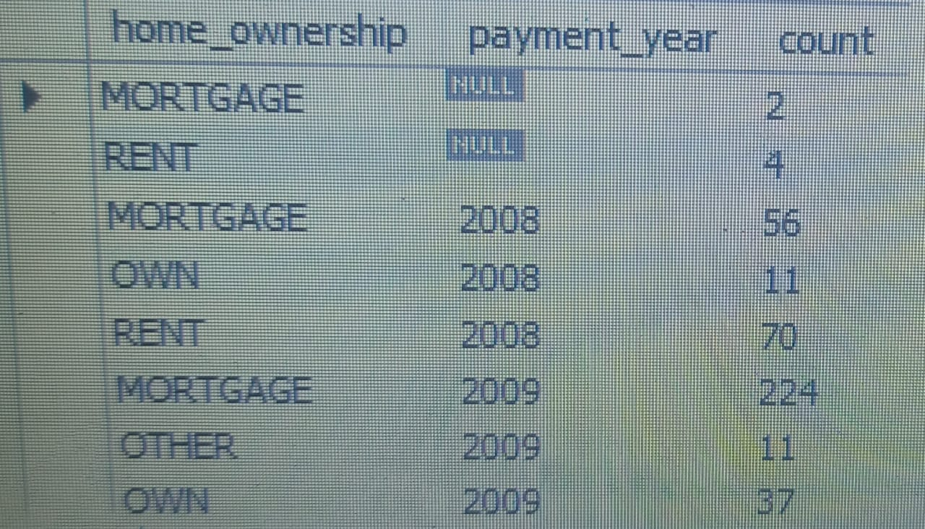
5) Home Ownership Vs Last Payment Date Stats - SELECT p.home_ownership, YEAR(s.last_pymnt_d) AS payment_year, COUNT(*) AS count FROM -- finance_1pp is aliased as p finance_1pp p INNER JOIN -- finance_2pp is aliased as s finance_2pp s -- The common column is Id, which exists in both tables ON p.Id = s.Id GROUP BY p.home_ownership, YEAR(s.last_pymnt_d) ORDER BY payment_year, p.home_ownership;

Slide 17
We Would Like to Thank Anand Sir for sharing their guidance and Expertise and we Thank All the members from other groups for supporting us in queries. It was really nice to working with you….!
Piyush R.
Rushikesh S.
Kiran K.
Thank You

